Slide 1
Interactive Data Exploration with Smart Drill-Down
Manas Joglekar
Hector Garcia-Molina
Aditya Parameswaran

Slide 2
Overview
Problem Setting and Motivation
Algorithm
System Architecture
Experiments

Slide 3
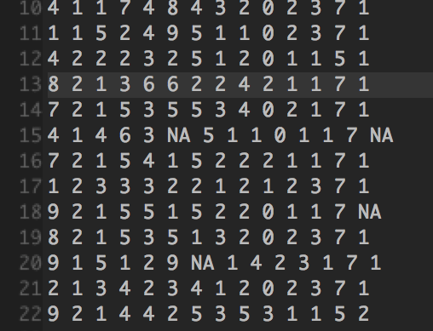
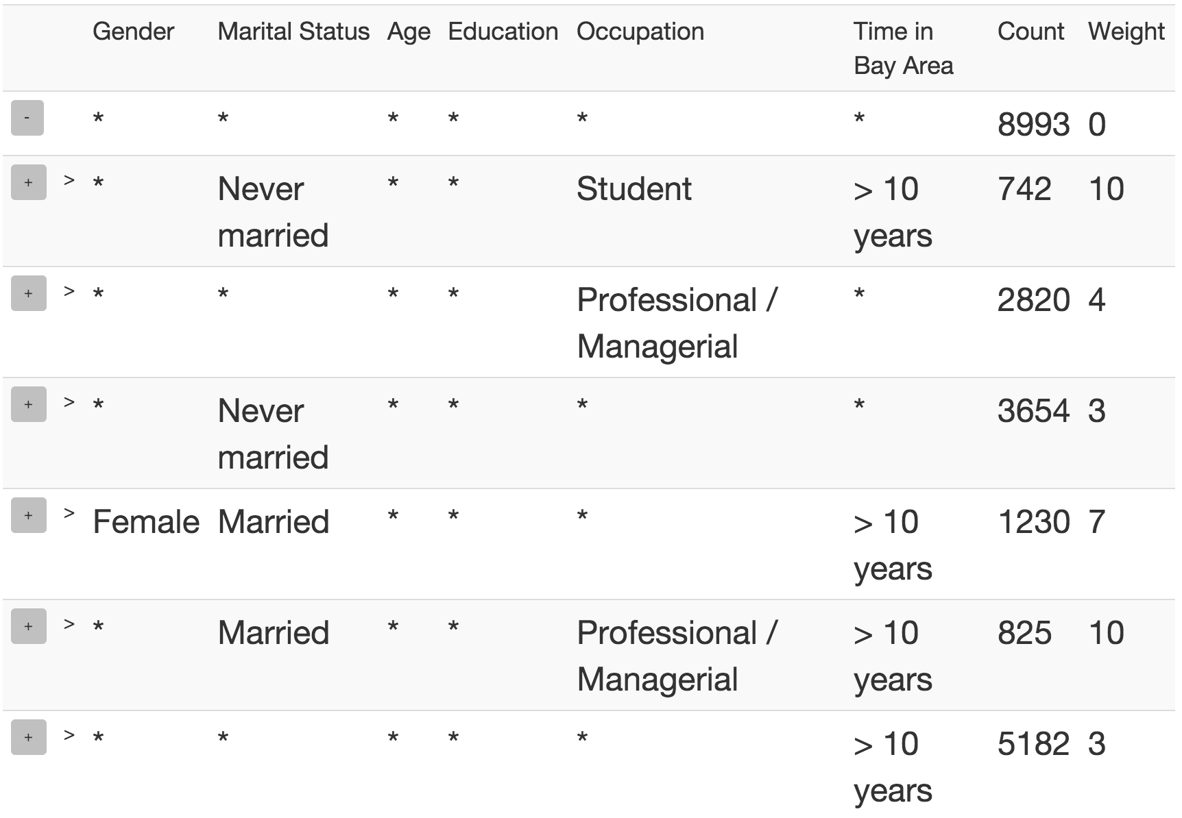
Motivation
Survey of marketing users
Hard to extract insights
Most interesting frequent `patterns’

Slide 4
OLAP Drill-Down

Slide 5
OLAP Drill-Down
Explore relational Databases
Drill Down/ Roll Up
$10 Billion market
Limitations
Too many values
Single column

Slide 6
Smart Drill-Down
Present k most interesting rules (patterns)
Find interesting portions faster
User tunable
Interactive
Instantiate multiple columns
Complementary functionality!
Notes:
User specified number of examples
Tunable Interestingess

Slide 7
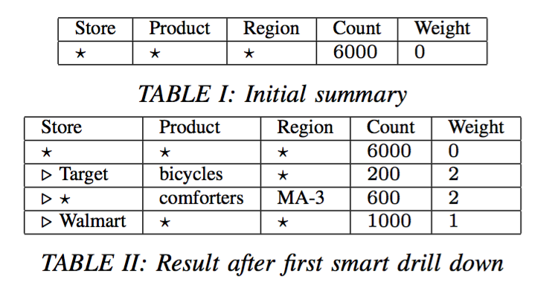
Example
Notes:
We want to summarize a table with 3 columns: Store, …
Start with single rule. Star is wildcard character
Count is number of tuples which match the pattern
So this tells us there ar 6000 tuples total

Slide 8
Example
Notes:
Expand into list of 3 rules.
Weight here is number of non-star values.
Weight defn can be tuned
Suppose user wants to know more about the Walmart tuples

Slide 9
Example

Slide 10
Example summary
Display best list of k (= 3) rules
Preference for
Higher Count
Higher Weight
Low overlap

Slide 11
Example summary
Display best list of k (= 3) rules
Preference for
Higher Count
Higher Weight
Low overlap
We now formalize the above notions
Notes:
Formalized later

Slide 12
Definitions
Rule: Tuple of values and *’s
Count(r): Number of tuples satisfying rule r
Size(r): Number of non-star values in r
Rule-List: Ordered list of rules
MCount(r,R): In a list R, number of tuples satisfying r but no rule before r

Slide 13
Definitions (cont’d)
Subrule(r₁,r₂): Strictly more specific rule
e.g. (a,b,*) is a subrule of (a,*,*)
Weight W: User-defined interestingess
W(r) ≥ 0
Monotone: Subrule(r₁,r₂) => W(r₁) >= W(r₂)

Slide 14
Definitions (cont’d)
Subrule(r₁,r₂): Strictly more specific rule
e.g. (a,b,*) is a subrule of (a,*,*)
Weight W: User-defined interestingess
W(r) ≥ 0
Monotone: Subrule(r₁,r₂) => W(r₁) >= W(r₂)
Score(R):

Slide 15
Formal Problem
Problem 1: Given a table T , a monotonic weighting function W, and a number k, find the list R of k rules that maximizes

Slide 16
Overview
Problem Setting and Motivation
Algorithm
System Architecture
Experiments

Slide 17
Ordering Rules Optimally
Theorem: Let R, R’ be rule-lists with same set of rules, where rules in R are sorted by weight (decreasing). Then
Notes:
Finding List = Finding Set + Finding Ordering
Latter Easy
Thus find set only
Still NP-Hard…

Slide 18
Ordering Rules Optimally
Theorem: Let R, R’ be rule-lists with same set of rules, where rules in R are sorted by weight (decreasing). Then
Thus, always sort rules by weight!
Find best set rather than list.
Still NP-Hard

Slide 19
Submodularity
Define
where S is rule-set, R is weight-sorted rule-list
Notes:
We had defined score for list. Now we define it for set in the obvious way.
If S is set, R_{S} is list obtained….

Slide 20
Submodularity
Define
where S is rule-set, R is weight-sorted rule-list
Then Score is submodular
i.e. let
Whenever
Notes:
We had defined score for list. Now we define it for set in the obvious way.
If S is set, R_{S} is list obtained….

Slide 21
Submodularity
Define
where S is rule-set, R is weight-sorted rule-list
Submodular Maximization:
Maximize Score(S) such that |S| = k
Notes:
We had defined score for list. Now we define it for set in the obvious way.
If S is set, R_{S} is list obtained….

Slide 22
Submodularity
Define
where S is rule-set, R is weight-sorted rule-list
Submodular Maximization:
Maximize Score(S) such that |S| = k
Greedy Algorithm
S = {}
r₁ = argmax_{r} (MarginalValue(r,S))
Notes:
We had defined score for list. Now we define it for set in the obvious way.
If S is set, R_{S} is list obtained….

Slide 23
Submodularity
Define
where S is rule-set, R is weight-sorted rule-list
Submodular Maximization:
Maximize Score(S) such that |S| = k
Greedy Algorithm
S = {r₁}
r₂ = argmax_{r} (MarginalValue(r,S))
Notes:
We had defined score for list. Now we define it for set in the obvious way.
If S is set, R_{S} is list obtained….

Slide 24
Submodularity
Define
where S is rule-set, R is weight-sorted rule-list
Submodular Maximization:
Maximize Score(S) such that |S| = k
Greedy Algorithm
S = {r₁, r₂}
r₃ = argmax_{r} (MarginalValue(r,S))
Notes:
We had defined score for list. Now we define it for set in the obvious way.
If S is set, R_{S} is list obtained….

Slide 25
Submodularity
Define
where S is rule-set, R is weight-sorted rule-list
Submodular Maximization:
Maximize Score(S) such that |S| = k
Greedy Algorithm
S = {r₁, r_{2, …} r_{k}}
Notes:
We had defined score for list. Now we define it for set in the obvious way.
If S is set, R_{S} is list obtained….

Slide 26
Submodularity
Define
where S is rule-set, R is weight-sorted rule-list
Submodular Maximization:
Maximize Score(S) such that |S| = k
Theorem: Greedy algorithm achieves a
approximation
Notes:
We had defined score for list. Now we define it for set in the obvious way.
If S is set, R_{S} is list obtained….

Slide 27
High level Algorithm
Notes:
Skip this (greedy algo should’ve been explained last slide)

Slide 28
Finding the best marginal rule
Brute-force: Compute marginal value for all rules?
Too expensive

Slide 29
Finding the best marginal rule
Brute-force: Compute marginal value for all rules?
Too expensive
Key Insight
If r₂ is sub-rule of r₁,

Slide 30
Finding the best marginal rule
Brute-force: Compute marginal value for all rules?
Too expensive
Max Weight Parameter m_{w}
A Priori-like algorithm
Evaluate all size 1, then 2, and so on
Only evaluate higher size rules that have a chance of being the best

Slide 31
Overview
Problem Setting and Motivation
Algorithm
System Architecture
Experiments

Slide 32
Scaling to large datasets
Run-time linear in table size
Doesn’t scale to millions of tuples
Slow if tuples not in main memory

Slide 33
Scaling to large datasets
Run-time linear in table size
Doesn’t scale to millions of tuples
Slow if tuples not in main memory
Solution: Sampling!
Low selectivity rules?
Multiple Weighted Samples

Slide 34
Scaling to large datasets
Sample Handler:
Predicts clicks and maintain samples
Subject to two user specified constraints
M : Available memory
minSS : Minimum sample size to compute rule-list

Slide 35
Scaling to large datasets
Sample Handler:
Predicts clicks and maintain samples
Subject to two user specified constraints
M : Available memory
minSS : Minimum sample size to compute rule-list
Optimal sample allocation: NP-Hard
DP approximation

Slide 36
System Architecture

Slide 37
Overview
Problem Setting and Motivation
Algorithm
System Architecture
Experiments

Slide 38
Experiments
Datasets
Marketing Survey
Census
Studies
Qualitative
Quantitative

Slide 39
Size weighting
k = 4
Size weighting favors columns with fewer distinct values

Slide 40
Bits weighting

Slide 41
Running time vs. mw
Notes:
Note that 2-3 seconds is almost ‘interactive time’

Slide 42
Running time vs. minSS
Notes:
Note that 2-3 seconds is almost ‘interactive time’

Slide 43
Count error vs. minSS
Notes:
Neglible error even at minSS = 1000.

Slide 44
Rule error vs. minSS

Slide 45
Conclusion
Smart Drill-Down augments and generalizes regular Drill-Down
Helps find interesting portions of a table fast
Interactive
Tunable
Fast with no preprocessing

Slide 46
Thank You!!
Questions?

Slide 47
Weight functions
Intrinsic interestingness of rule
Examples
Size : Number of non-star values
Bits : Number of bits needed to specify non-star values
Bits favors columns with more distinct values
Notes:
User tunable. Only two restrictions
Skip examples

